Slide 1

Presented by - Ruban Shanmugam
Opportunity Analysis of Major F&B Manufacturer

Slide 2
Case Statement :
Get a quick view of share of total spends and F&B spends for existing customers (restaurants)
What are the adjacent opportunities from the non-commercial establishments to additionally sell into (note that there are no customers currently in the non-commercial segment)
Retailers is a different business division and hence out of scope for me (Shaun), but some of my customers / prospects could be buying from these retailers – so getting a view of retailer presence adjacent to his customers & prospects will help understand how much of these opportunities are being met / unmet.

Slide 3
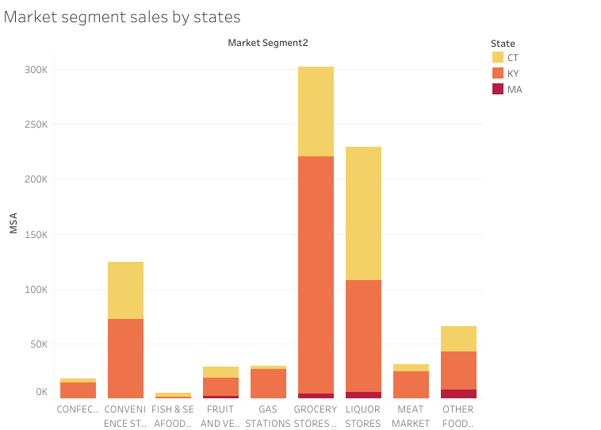
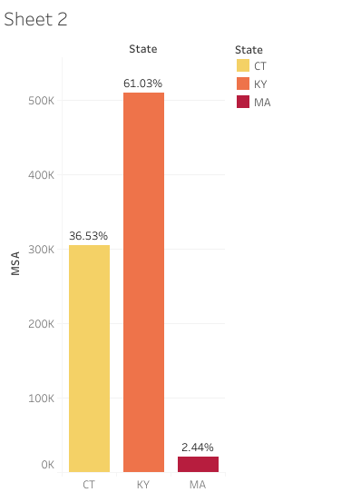
Analysis Of Customer’s Annual Sales in stores and states From Shaun's Company
Insights & opportunities:
The data was only available for three states “CT”, “KY” and “MA”. So the data is based on only these 3 states.
Based on the above data most of the Retail stores are present in “KY”. Which is nearly around 90% . The retail stores present in KY will be a highly profitable place to expand the business in order to save Transportation charges and to provide a seamless delivery of the products.

Slide 4
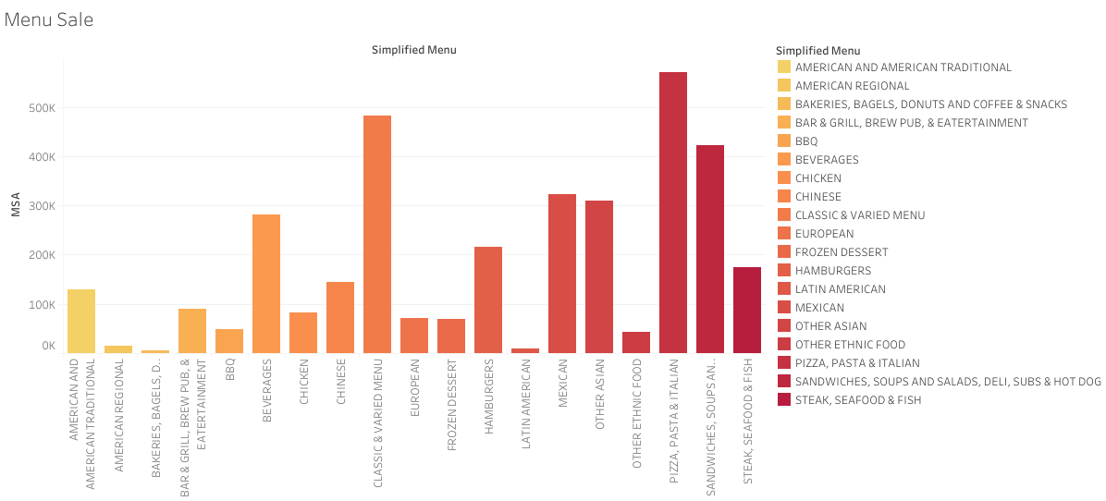
Analysis Of Customer’s Annual Sales based on Simplified Menu
Insights & Opportunities:
By analysing the “Annual Sales” by “Menu”, The Data reveals that the Italian, Classic, Sandwiches & Subs, Beverages and Asian Menu’s performs well interims of sales. the business can be further improved by Increasing the relationships with restaurants offering these Menus.

Slide 5
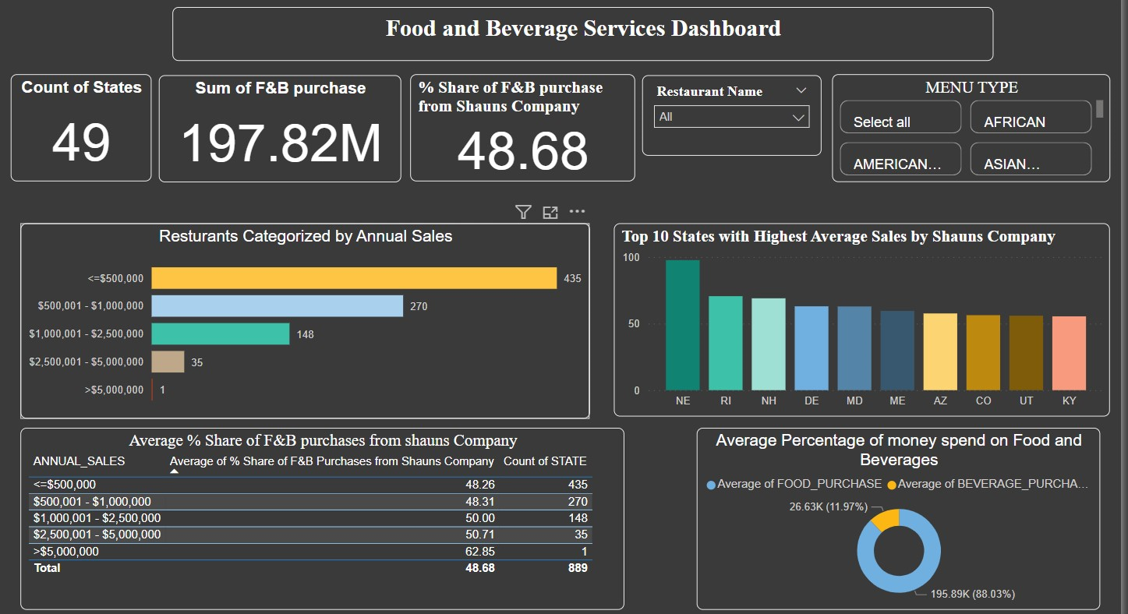
F&B Interactive Dashboard Sample

Slide 6
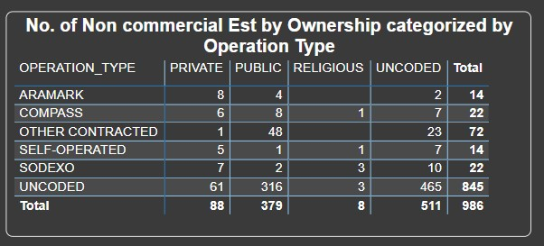
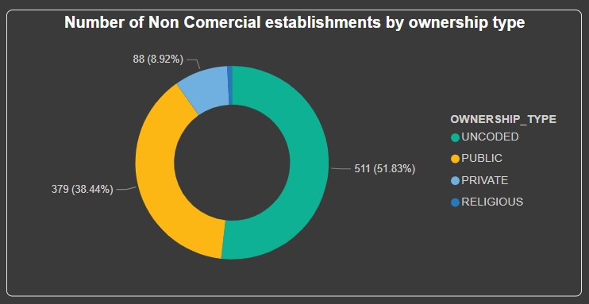
Opportunities Available In Non-commercial Establishments (Operation type categorized by Ownership type )
Insights & Opportunities:
The maximum number of Establishments like hospitals have ownership type “Public”. Which has a highest percentage value compared to “Private” and “Religious” Establishments.
Most of these “Public” Establishments are “Contract Basis”. So there is a high opportunity to expand the business by signing a contract with these Public Establishments.

Slide 7
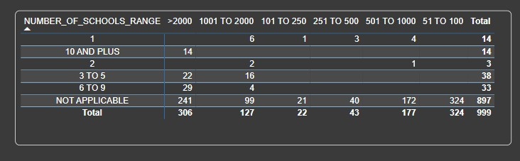
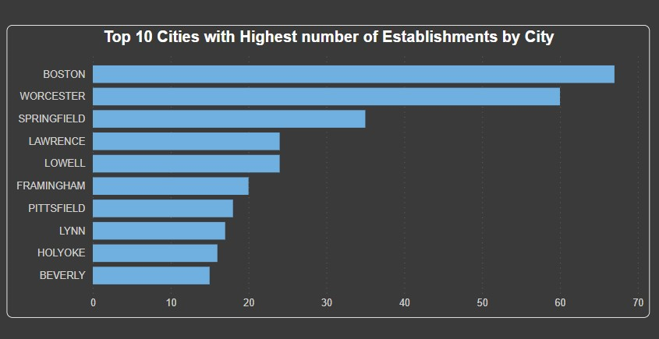
Opportunities Available In Non-commercial Establishments (Number Of Meals Provided By Schools)
Insights & Opportunities:
No Data was provided other than the State “MA”. So the Analysis is completely based on “MA”.
The number of schools ranges from 3-5, 6-9 and more than 10 offered the maximum number of meals in a day. These places can be a good opportunity to expand the business.
Most of the Non commercial establishments are located in Boston, Worcester and Springfield. These Top 3 cities can be used as a opportunity to expand the business.

Slide 8
Conclusions:
After analysing the datasets I conclude that;
Shaun’s company has good relationships with restaurants generating sales revenue of more than $500,000, Where most of them have more than 50% of F&B purchases from Shaun's company.
Shaun’s company has to improve relationships with restaurants generating sales revenue > $1,000,000. There is a total of “705” restaurants that falls withing this range which will be a good opportunity to improve the business.
It would be beneficial for Shaun’s company to make good relationship with non commercial establishments working on contract basis in cities like Boston, Worcester and Springfield where the number of school ranges above 3 and provides more than 2000 meals per day.
Most of the retail stores generating higher sakes revenue are present in KY. The Retail store types which has the highest revenues are (Grocery Stores, Liquor Stores and Convenience Stores). Hence based on good reputation of Shaun's company with the restaurants generating sale revenue of =<$500,000, it would be beneficial for him to develop a good relationship with retail stores like (Grocery Stores, Liquor Stores and Convenience Stores) adjacent to his customers in KY (Kentucky) making a sale revenue of =<$500,000.

Slide 9
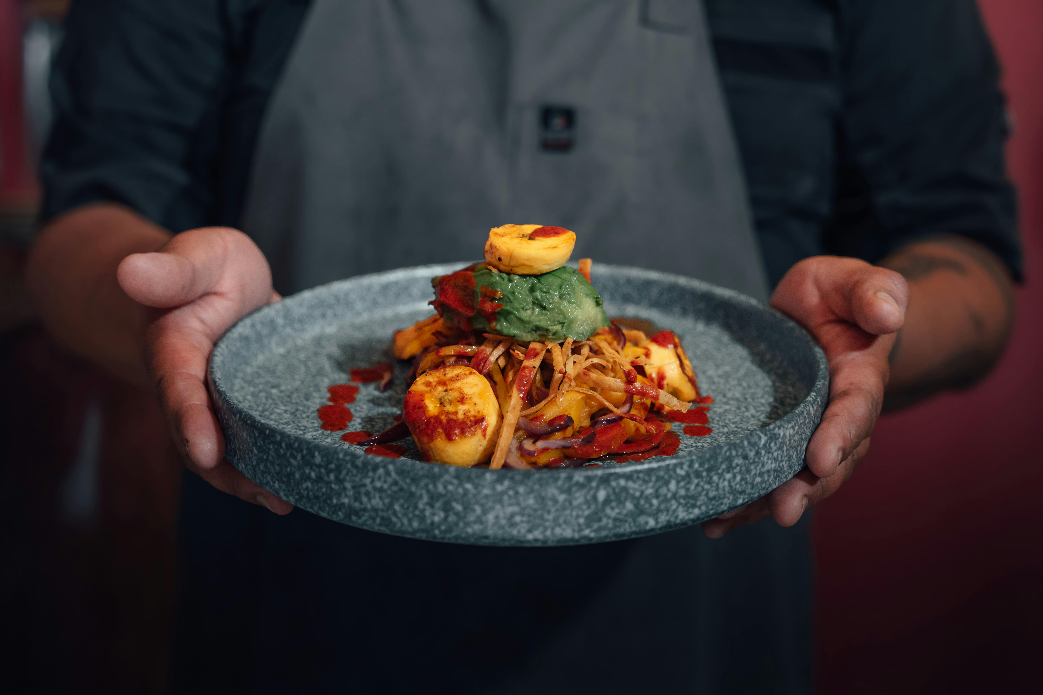
Thank you
Name : RubanShanmugam
Email : rubanshanmugam02gmail.com

